Slide 1
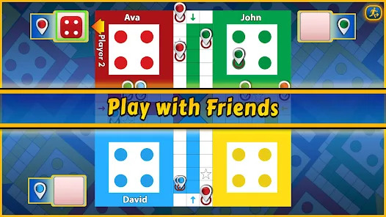
CSE299 Junior Design Project 28 June, 2026 Section 03 course instructor: Mohammad shifat-e-rabbi
Web-Based Real-Time Multiplayer
Ludo Game
Team Project
Proposal
By
Musanna Ibn Amin 2233285042
Mohiuddin Sefat 2231193642
Sakiha Zaman 2233351642
Ishraq Hossain Rodro 2311675042
Shihab Uddin Patwary 2132685642
Md. Sajidul Islam 2121935642

Slide 2

Introduction & Motivation
Popular board game brought to the web
No installation required
Accessible from desktop and mobile
Real-time multiplayer experience

Slide 3
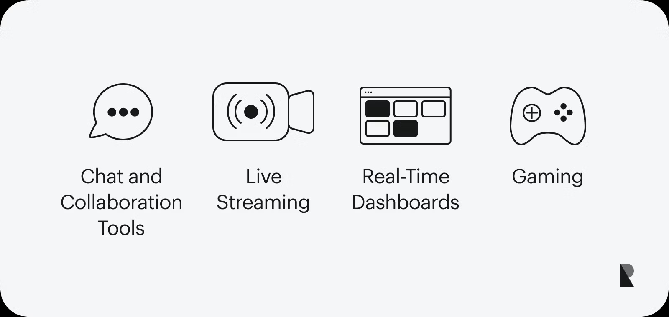
Objectives
Real-time synchronization
Secure authentication system
Cross-device compatibility
Lobby & matchmaking
Reliable state management

Slide 4
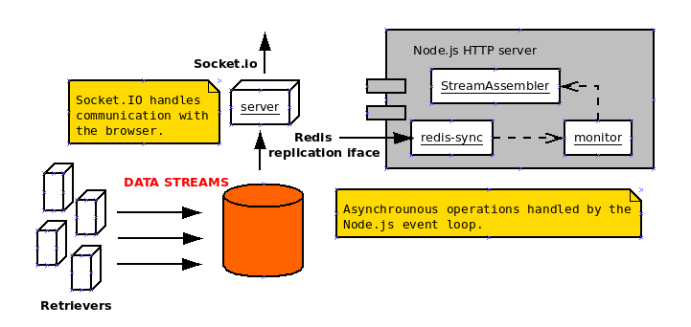
System Architecture
Client: React.js
Server: Node.js + Express
Realtime: Socket.io
Database: MongoDB/PostgreSQL
Server authoritative game logic

Slide 5
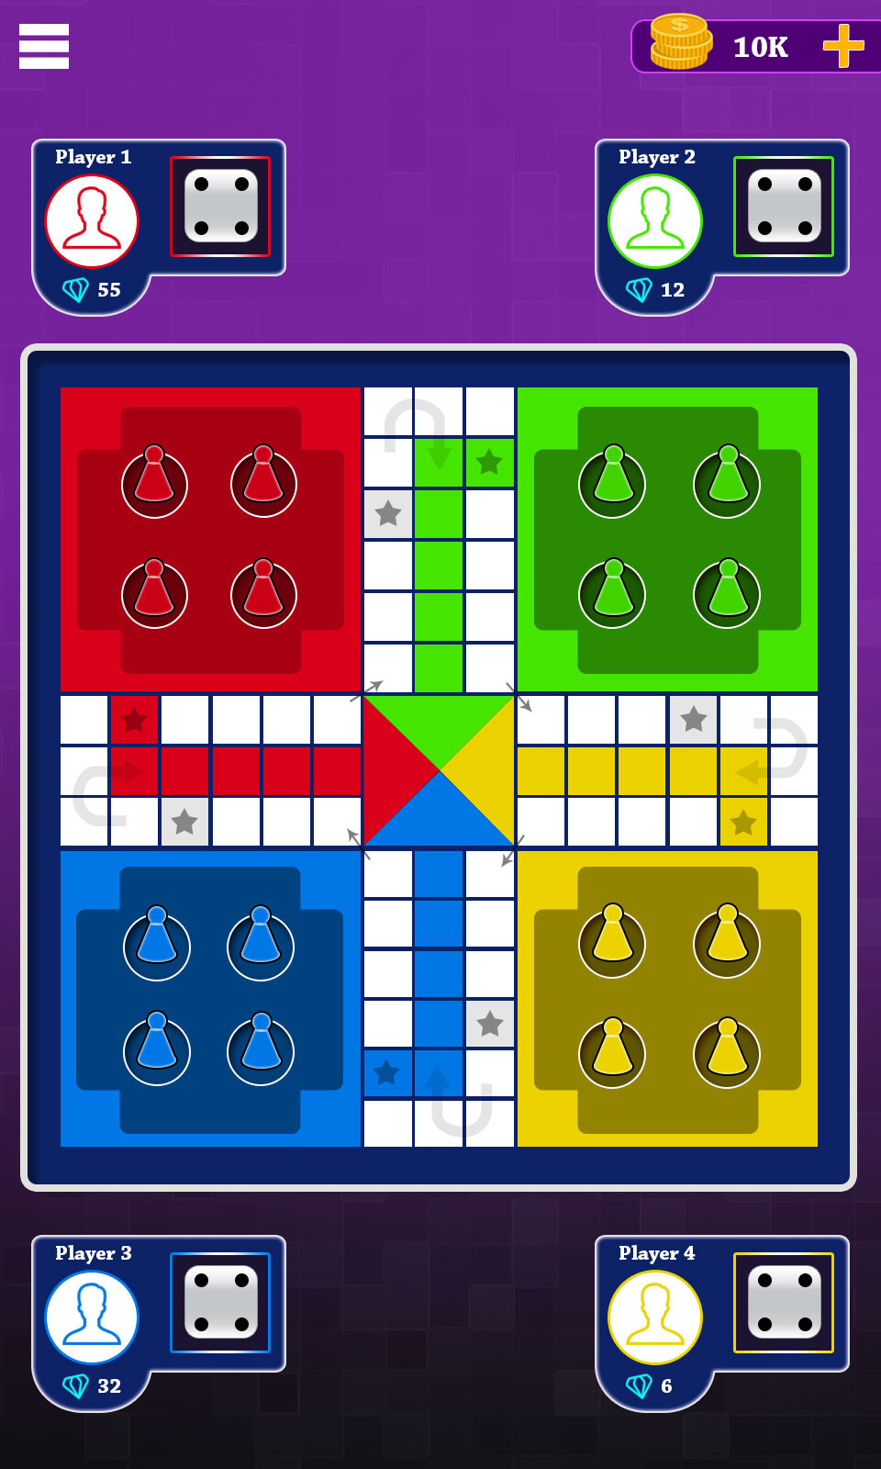
Gameplay Workflow
1. Create/Join Room
2. Start Match
3. Roll Dice
4. Validate Move
5. Broadcast State
6. Win Detection

Slide 6
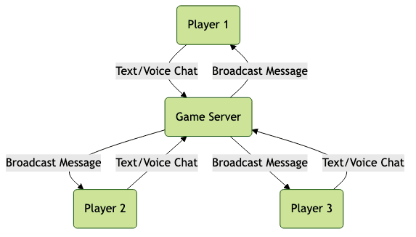
Features
Core:
Authentication
Multiplayer
Standard Rules
Responsive UI
Stretch:
Chat
AI Player
Multiple Themes

Slide 7
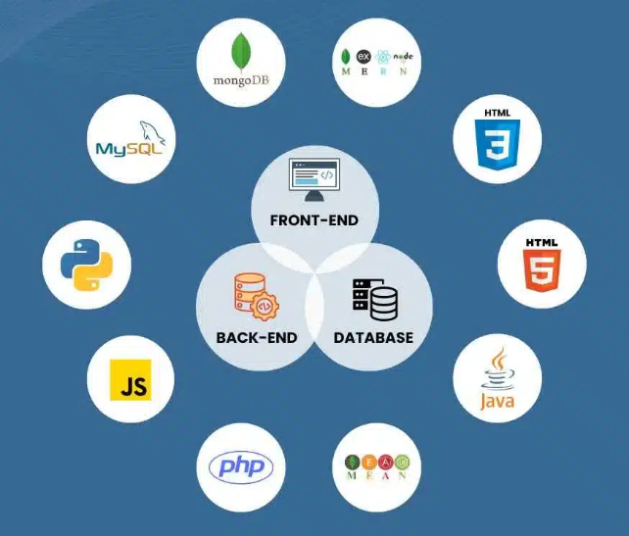
Expected Outcomes
Public deployment
Centralized backend
Documentation & diagrams
Full-stack development

Slide 8
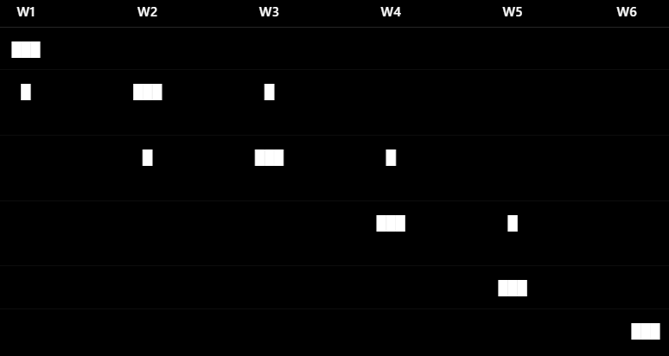
Timeline
Week:
1. Design
2. Frontend
3. Backend
4. Integration And Testing
5. Bug Fixing
6. Demo

